Slide 1

Applied Data Science Capstone
Opening a restaurant in Singapore
By Thet Paing Htet
February 2020

Slide 2
Business Problem
Location of the restaurant is one of the most important decisions that will determine whether the restaurant will be a success or a failure
Objective : To analyse and select the best locations in the Singapore to open a new restaurant.
This project is timely as the city is currently suffering from oversupply of restaurant.
Business question
In the Singapore , if a property developer is looking to open a new restaurant, where would you recommend that they open it?

Slide 3
Data
Data required
List of Town in Singapore
Latitude and longitude coordinates of the townships
Venue data , particularly data related to restaurants
Sources of data
Singapore Open Data Website (https://data.gov.sg/)
Foursquare Data API for venue data

Slide 4
Methodology
Web Scraping Wikipedia page for neighbourhoods list
Get latitude and longitude coordinates using Geocoder
User Foursquare API to get venue data
Group data by neighbourhood and taking the mean of the frequency of occurrence of each venue category
Filter venue category by Restaurants
Perform clustering on the data by using k-means clustering

Slide 5
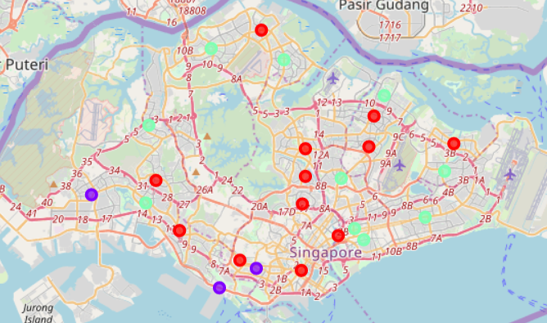
Results
Categorized the neighbourhoods into 3 clusters:
Cluster 0 : Townships with high concentration of restaurants
Cluster 1 : Townships with low number of restaurants
Cluster 2 :Townships with moderate number of restaurants

Slide 6
Discussion
Most of the restaurants are concentrated in the area where most of the households are located
Highest number in cluster 0 and moderate number in cluster 2
Cluster 1 has very low number of restaurants in the Townships
Oversupply of restaurants mostly happened in the area where most of the households are located , with the suburb area still have very few restaurants

Slide 7
Recommendation
Open new restaurants in Townships in cluster 1 with little to no competition
•Can also open in townships in cluster 2 with moderate competition if have unique selling propositions to stand out from the competition
•Avoid townships in cluster 2, already high concentration of restaurants and intense competition

Slide 8
Conclusion
Answer to business question: The townships in cluster 2 are the most preferred locations to open a new restaurants
•Findings of this project will help the relevant stakeholders to capitalize on the opportunities on high potential locations while avoiding overcrowded areas in their decisions to open a new restaurants

Slide 9


